Slide 1
FILE SYSTEM
File concept
File support
Access methods
Allocation methods
Directory systems
File protection
Free space management

Slide 2
File Concept
A file is a named collection of related information that is recorded on secondary storage.
In general, a file is a sequence of bits, bytes, lines, or records, the meaning of which is defined by the file's creator and user.

Slide 3
File Concept
A file has a certain defined structure according to its type.
A text file is a sequence of characters organized into lines (and possibly pages).
A source file is a sequence of subroutines and functions, each of which is further organized as declarations followed by executable statements.
An object file is a sequence of bytes organized into blocks understandable by the system's linker.
An executable file is a series of code sections that the loader can bring into memory and execute.

Slide 4
File Structure
A file has a certain defined structure, which depends on its type
A text file is a sequence of characters organized into lines
A source code file is a sequence of declarations, statements, and subroutine definitions
An object code file and an executable file each contain a sequence of bytes organized into headers and tables of data and code understandable by a system linker and loader

Slide 5
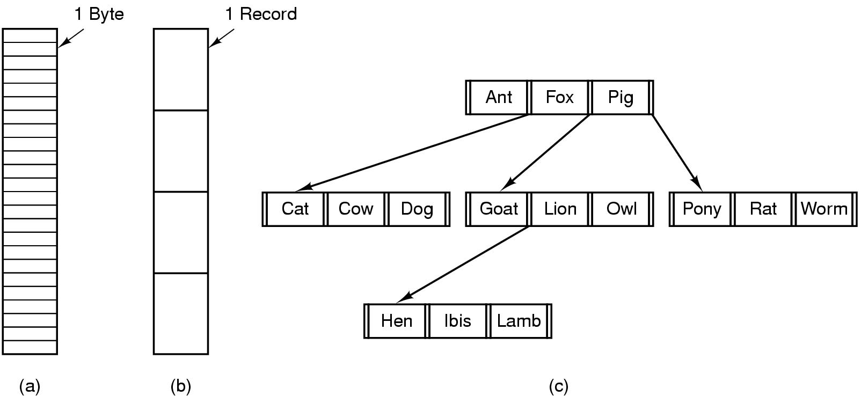
File Structure
Three kinds of files
byte sequence
record sequence
tree

Slide 6
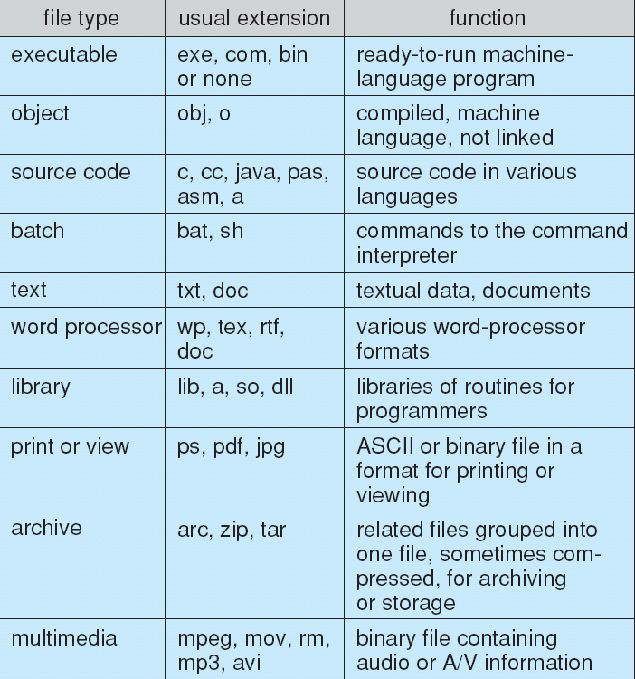
File Types – Name, Extension

Slide 7
File Access
Sequential access
read all bytes/records from the beginning
cannot jump around, could rewind or back up
convenient when medium was mag tape
Random access
bytes/records read in any order
essential for data base systems
read can be …
move file marker (seek), then read or …
read and then move file marker

Slide 8
File Attributes
Name – the only information kept in human-readable form
Identifier – unique tag (a number) that identifies file within the file system
Type – used by systems that support different types of files
Location – pointer to file location on a device
Size – current file size in bytes, words, or blocks
Protection – access controls for who can read, write, and execute
Time, date, and user identification – used for documenting file creation, last modification, and last use

Slide 9
File Operations
Create
Delete
Open
Close
Read
Write
Append
Seek
Get attributes
Set Attributes
Rename

Slide 10
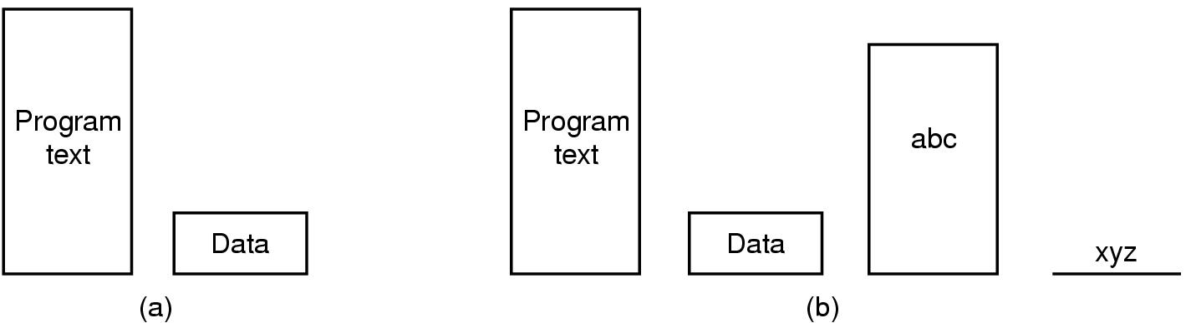
Memory-Mapped Files
(a) Segmented process before mapping files into its address space
(b) Process after mapping
existing file abc into one segment
creating new segment for xyz

Slide 11
Memory-Mapped Files
A memory-mapped file contains the contents of a file in virtual memory.
Enables an application, including multiple processes, to modify the file by reading and writing directly to the memory.
There are two types of memory-mapped files:
Persisted memory-mapped files
Non-persisted memory-mapped files
Memory-mapped files can be shared across multiple processes.
Processes can map to the same memory-mapped file by using a common name that is assigned by the process that created the file.

Slide 12
To work with a memory-mapped file, you must create a view of the entire memory-mapped file or a part of it.
You can also create multiple views to the same part of the memory-mapped file, thereby creating concurrent memory.
For two views to remain concurrent, they have to be created from the same memory-mapped file.
There are two types of views: stream access view and random access view.
Use stream access views for sequential access to a file; this is recommended for non-persisted files and IPC.
Random access views are preferred for working with persisted files.

Slide 13
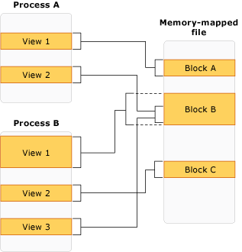
multiple processes can have multiple and overlapping views to the same memory mapped file

Slide 14
Memory-Mapped Files
Persisted memory-mapped files
Persisted files are memory-mapped files that are associated with a source file on a disk.
When the last process has finished working with the file, the data is saved to the source file on the disk.
These memory-mapped files are suitable for working with extremely large source files.

Slide 15
Memory-Mapped Files
Non-persisted memory-mapped files
Non-persisted files are memory-mapped files that are not associated with a file on a disk.
When the last process has finished working with the file, the data is lost and the file is reclaimed by garbage collection.
These files are suitable for creating shared memory for inter-process communications (IPC).

Slide 16
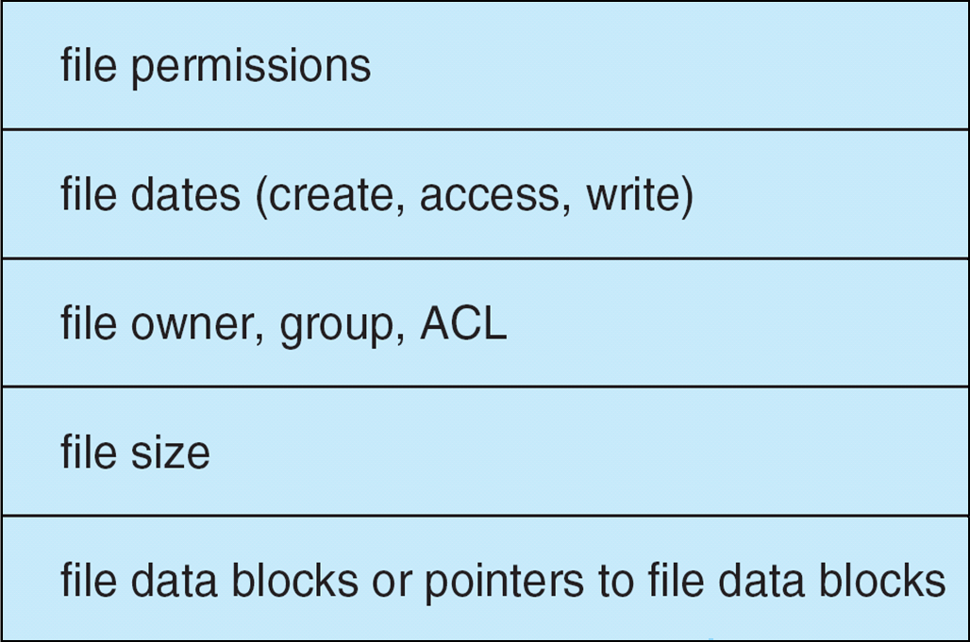
File System Implementation
File Control Block

Slide 17
Allocation Methods
How should file system allocate disk blocks to each file?
Contiguous Allocation
Linked Allocation
Indexed Allocation

Slide 18
Contiguous Allocation
Each file occupies a set of contiguous blocks on the disk.
Simple – only starting location (block #) and length (number of blocks) are required.
Both sequential and direct access is supported
For sequential access, the file system remembers the disk address of the last block referenced and, when necessary, reads the next block.
For direct access to block i of a file that starts at block b, we can immediately access block (b + i) .

Slide 19
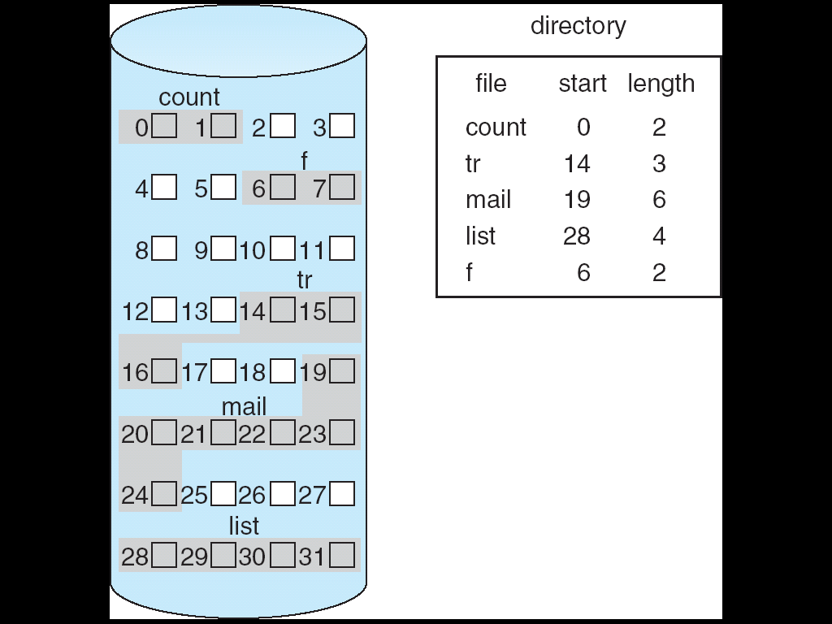
Contiguous Allocation

Slide 20
Contiguous Allocation
Contiguous allocation has some problems
Dynamic storage-allocation
How to satisfy a request of size n from a list of free blocks
External fragmentation
Free space is broken into chunks and the largest chunk is insufficient for a request
Determining how much space is needed for a file
When the file is created, the total amount of space it will need must be found and allocated. How does the creator know the size of the file to be created?
If Allocated too little and the file may not be extended.
If allocated too much and space is wasted.
File cannot grow

Slide 21
Linked Allocation
Each file is allocated a linked list of disk blocks: blocks may be scattered everywhere on the disk.
block =
pointer

Slide 22
Linked Allocation
Simple – need only starting address
Solves all the problems of contiguous allocation
Size of file need not be declared at the time of creation
Free-space management system – no wastage of space
No external fragmentation
Effective sequential access but no random access

Slide 23
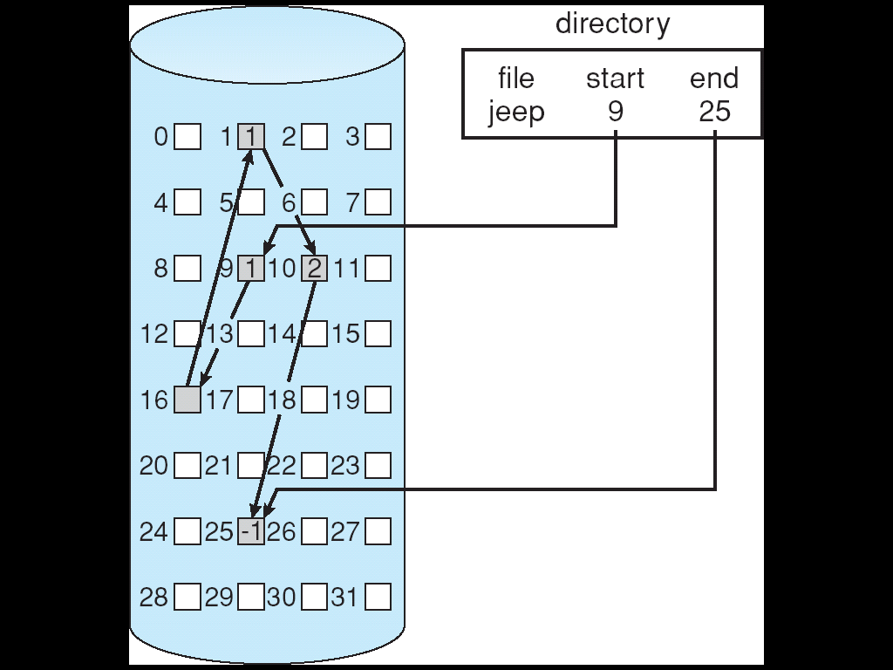
Linked Allocation
0
6
1

Slide 24
Linked Allocation
To create a new file:
Create a new entry in the directory.
Each directory entry has a pointer to the first disk block of the file.
This pointer is initialized to nil to signify an empty file.
The size field is also set to 0.
To write the file:
Search a free block .
This new block is then written to, and is linked to the end of the file.
To read a file:
Read blocks by following the pointers from block to block.

Slide 25
Linked Allocation
Disadvantages
It can be used effectively only for sequential access
Random access is expensive
To find the i^{th} block, we must start from the beginning of the file and follow the pointers until we get the i^{th} block
If a pointer needs 4 bytes out of 512 byte block then, the user sees blocks of 508 bytes.
Maximum memory is wasted for pointers.
Pointer space: Maximum disk space is used for pointers

Slide 26
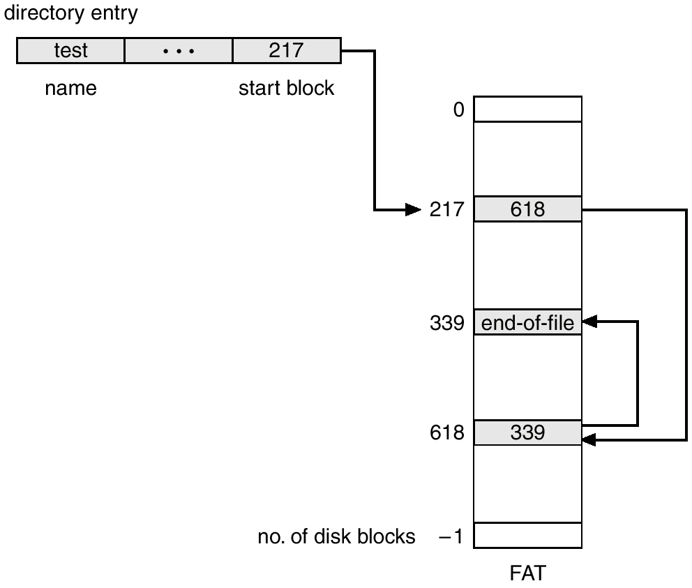
File-Allocation Table This is a variation of linked allocation
The table has one entry for each block and is indexed by block number.
Unused blocks are indicated by 0 table value.
Allocating a new block involves finding the first 0 valued table entry and replacing the previous end-of-file value with the address of the new block
The directory entry contains the block number of the first block of the file.

Slide 27
Indexed Allocation
Each file has its own index block, which is an array of disk-block addresses
Supports direct access by bringing all the pointers together into the index block
To read ith block , read index block entry, gives direct access.
Dynamic allocation without external fragmentation, but has overhead of index block.
Logical view.
index table

Slide 28
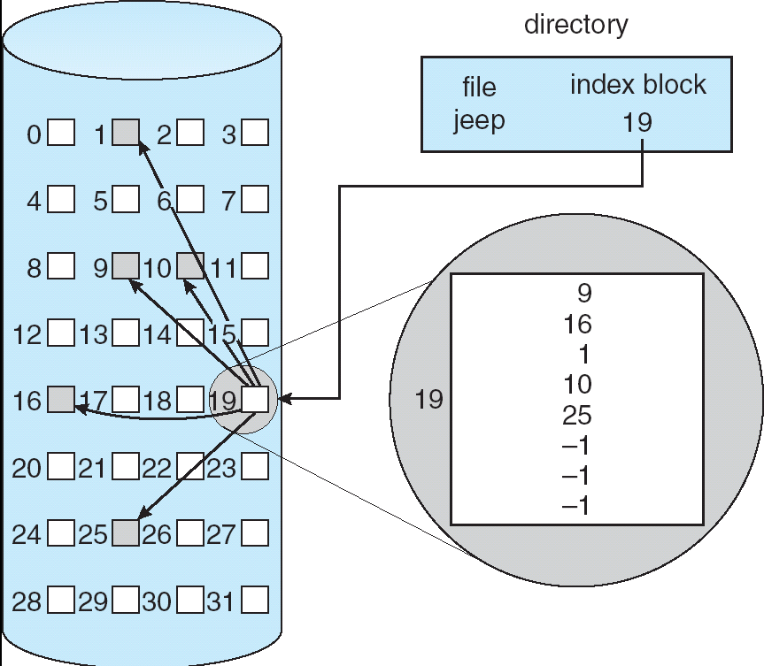
Indexed Allocation
To create file:
All pointers in the index block are set to nil.
To write a block:
When the ith block is first written, a block is obtained from the free-space manager, and its address is put in the ith index-block entry.

Slide 29
Indexed Allocation
The pointer overhead of the index block is generally greater than the pointer overhead of linked allocation.
Consider a file of only two blocks. With linked allocation, we lose the space of only one pointer per block
With indexed allocation, an entire index block must be allocated.
The question: How large the index block should be?
Every file must have an index block, so we want the index block to be as small as possible. If the index block is too small, however, it will not be able to hold enough pointers for a large file.

Slide 30
Indexed Allocation
Indexed Allocation schemes
Linked scheme
Multilevel index scheme
Combined scheme

Slide 31
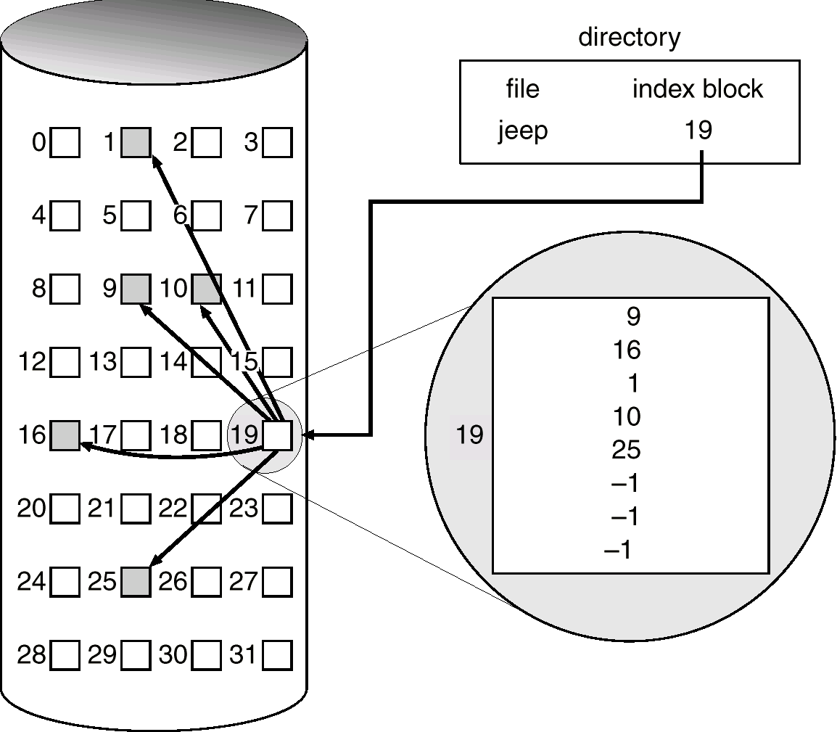
Linked Scheme in Index Allocation
Index blocks are divided for larger files and linked to each other.
Advantage:
Adjustable to any size of files
Disadvantages:
Slower random accesses for larger files
4
5
6
.
.
.
.
28
27
29
30

Slide 32
Indexed Allocation – Multilevel indexing
To access a block, the operating system uses the outer-level index to find a inner-level index block, and that block to
find the desired data block.

outer-index
index table
file

Slide 33
Indexed Allocation – Two level indexing
With 4,096-byte blocks, we could store 1,024, 4-byte pointers in an index block. Two levels of indexes allow 1,048,576 data blocks, which allows a file of up to 4 GB.

Slide 34
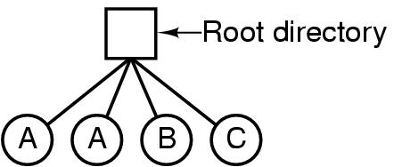
Directories Single-Level Directory Systems
A single level directory system
contains 4 files
owned by 3 different people, A, B, and C

Slide 35
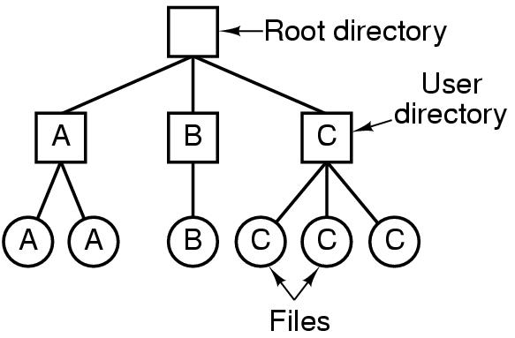
Two-level Directory Systems
Letters indicate owners of the directories and files

Slide 36
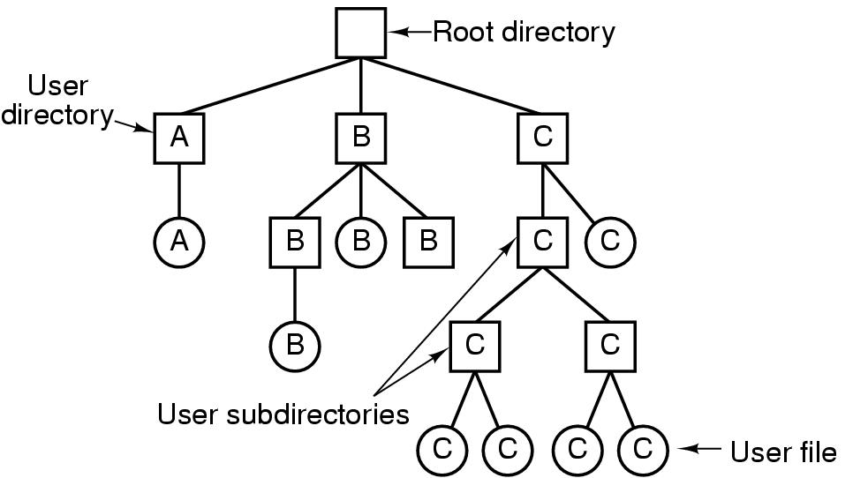
Hierarchical Directory Systems

